Slide 1
Competences and skills needed for using Gen-AI and OER
Robert Schuwer

Slide 2
Skills and competences for using OER

Slide 3
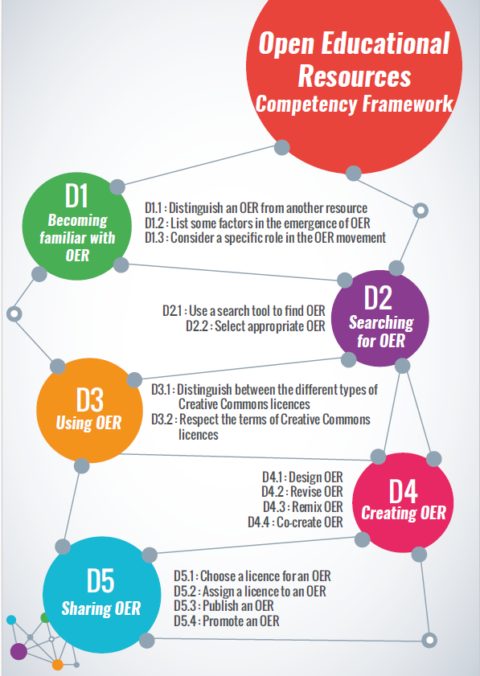
(IOF, 2016)

Slide 5
Skills and competences for using (Gen-)AI

Slide 6
Framework
UNESCO effort toward competency frameworks for teachers and students
Objectives:
Teacher: define the knowledge, skills and attitudes that teachers should possess to understand the roles of AI in education and utilize AI in their teaching practices in an ethical and effective manner
Student: articulate the knowledge, skills and attitudes students should acquire to understand and actively engage with AI in a safe and meaningful manner in education and beyond
Publishing foreseen in Digital learning week 2024
(UNESCO, 2023)

Slide 7
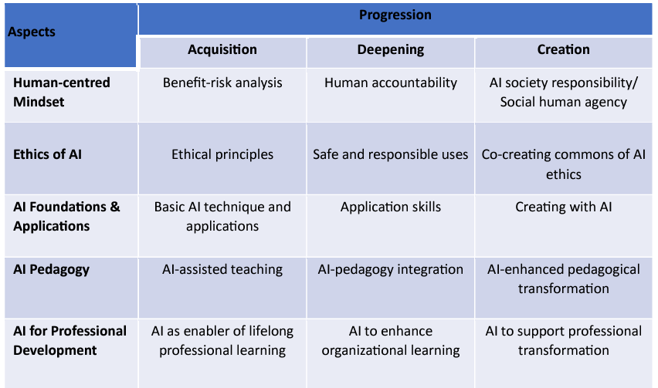
Competences needed for teachers

Slide 8
Competences needed for teachers
Generic

Slide 9
Competences needed for teachers
Creating

Slide 10
Competences needed for teachers
Educational use

Slide 11
Combining both frameworks for a teacher

Slide 16
robert@robertschuwer.nl
https://www.robertschuwer.nl

Slide 17
Colophon
Author: Robert Schuwer.
This presentation is available under a Creative Commons Attribution 4.0 International (CC BY 4.0) license. For attribution use the following phrase:
Schuwer, R. (2024). Competences and skills needed for using Gen-AI and OER. https://robertschuwer.nl/download/slides/20240125/vid03.pptx
References
Used in this presentation and for further reading
Bozkurt, A. (2023). Generative AI, synthetic contents, open educational resources (OER), and open educational practices (OEP): A new front in the openness landscape. Open Praxis, 15(3), 178-184. https://doi.org/10.55982/openpraxis.15.3.579
Buist-Zhuk, M., Beldhuis, H., Schuwer, R., & Täuber, S. (2023). Recognition & Rewards for working with Open Educational Practices and Open Educational Resources. https://www.robertschuwer.nl/download/RecRewEN.pdf.
Coolidge, A., McKinney, A., & Shenoy, D. (n.d.). Tenure and promotion. DOERS3. https://www.doers3.org/tenure-and-promotion.html
International Organisation of La Francophonie (IOF) (2016). Open Educational Resources Competency Framework OER. https://unesdoc.unesco.org/ark:/48223/pf0000266159_eng
Miao, F., & Holmes, W. (2023). Guidance for generative AI in education and research. UNESCO, Paris. https://unesdoc.unesco.org/ark:/48223/pf0000386693
UNESCO (4 December 2023). AI competency frameworks for school students and teachers. UNESCO. https://www.unesco.org/en/digital-education/ai-future-learning/competency-frameworks

